Slide 1

Name : Bikram Lamichhane
Production Project

Slide 2
Overview
Here we propose a web-based system that allows users to get instant guidance on their health issues through an intelligent health care system online. This health prediction system allows users to share their symptoms. It then processes user’s symptoms to check for various illness that could be associated with it. Here we use intelligent system of Naïve Bayes algorithm and depending on the symptoms system will guess his/her diseases and suggested him/her right doctor.

Slide 3
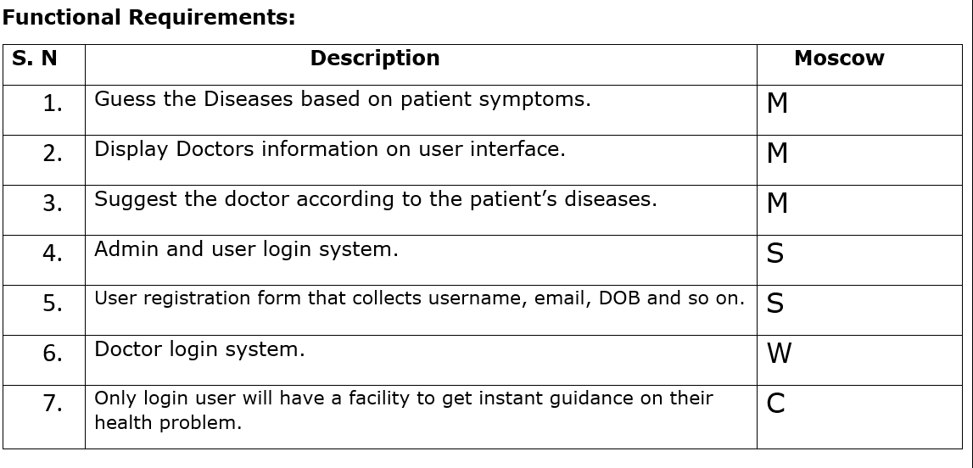
MOSCOW

Slide 4
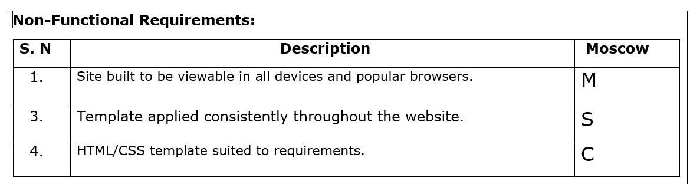
Moscow

Slide 5
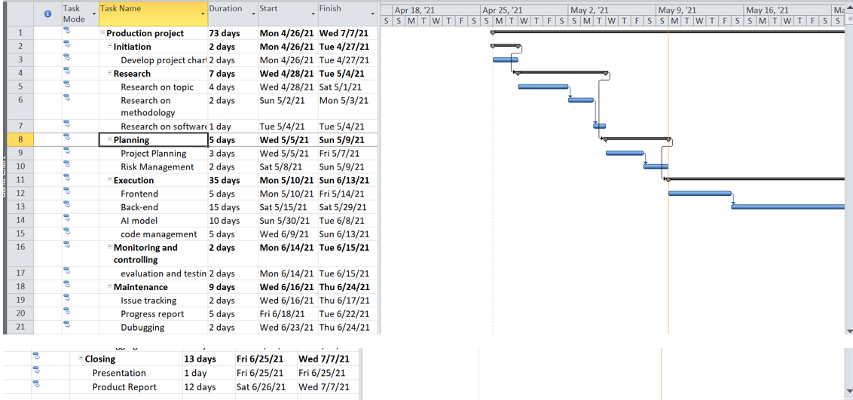
Gantt chart

Slide 6
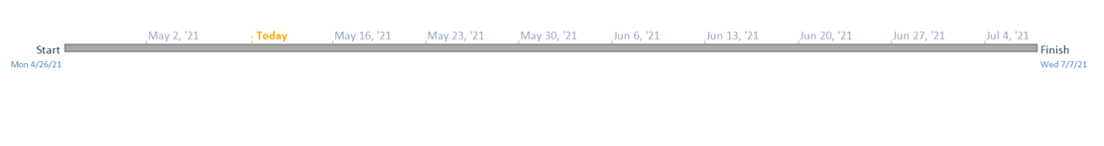
Timeline

Slide 7
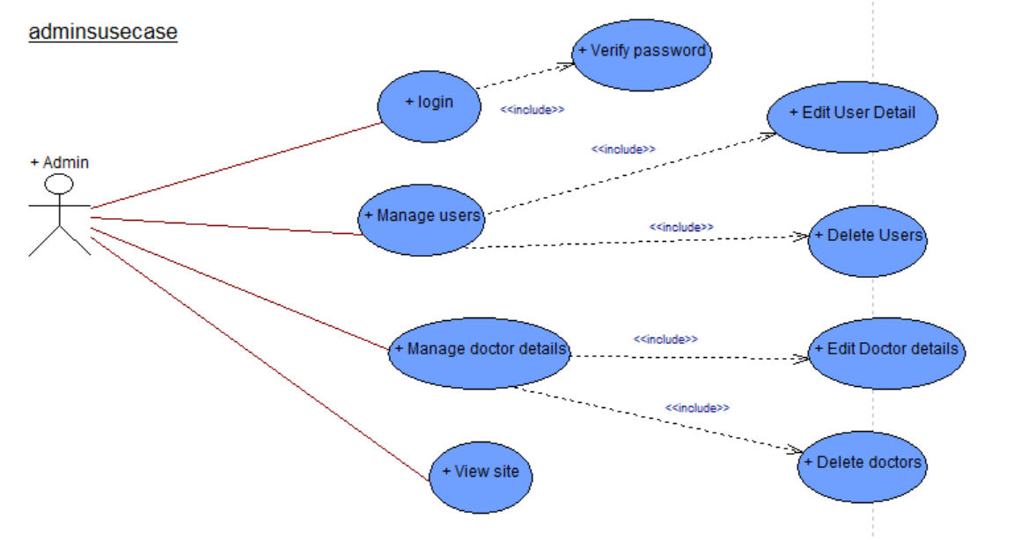
Admin Use case

Slide 8
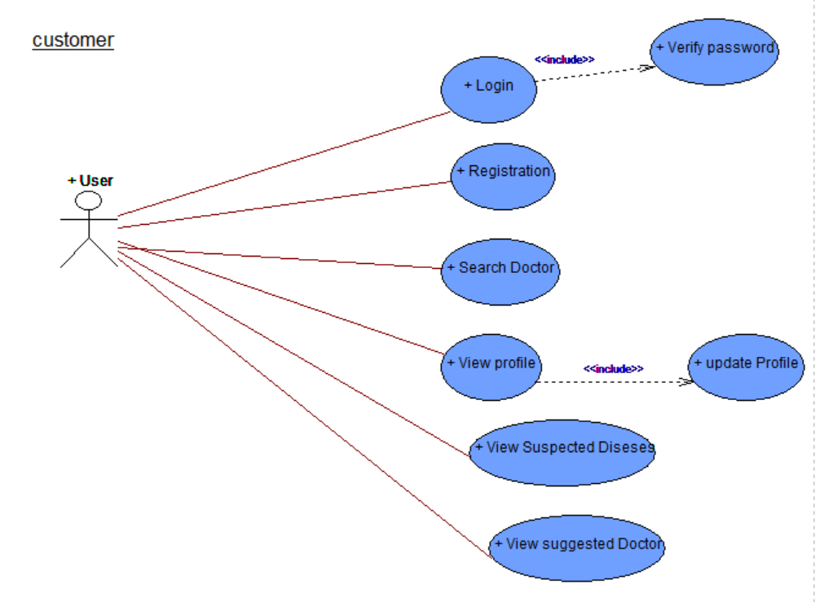
User use case

Slide 9
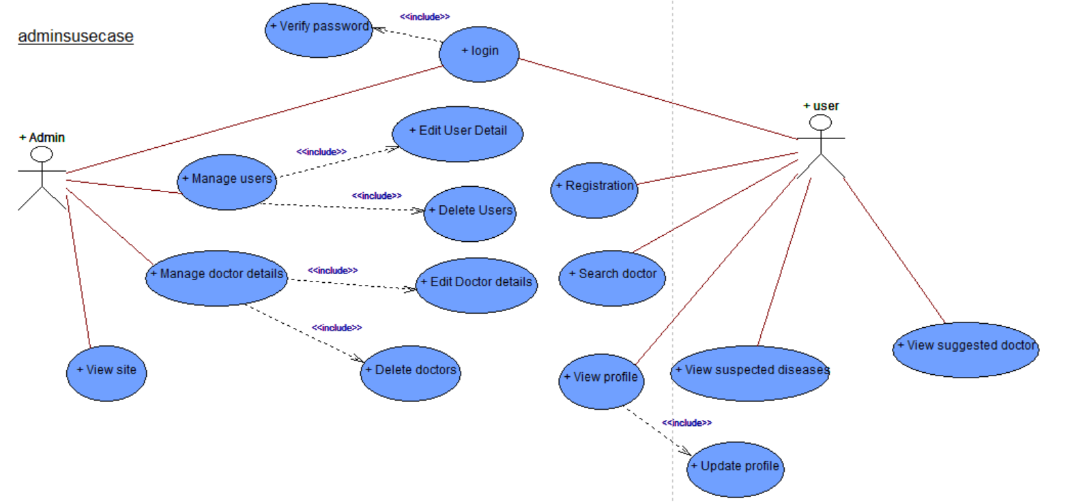
Overview use case

Slide 10
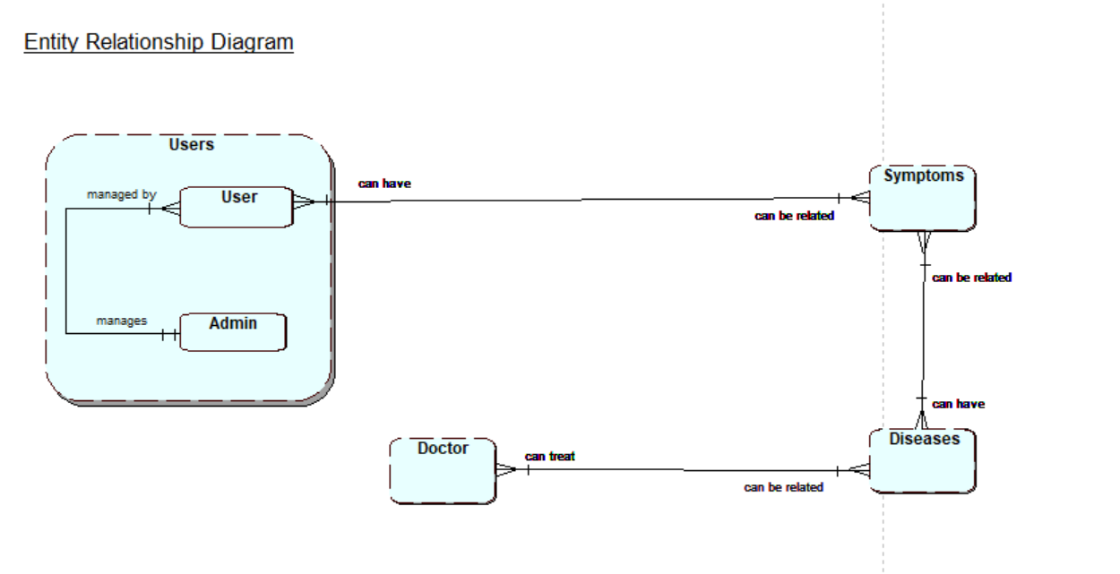
ERD

Slide 11

Work in progress

Slide 12

Thank you !!

